Slide 1
CS F415: Data Mining
Yashvardhan Sharma

Slide 2
Today’s Outline
Data Preprocessing
Dimensionality Reduction
Feature Selection
Discretization
Measure of Similarity and dissimilarity
Transformation

Slide 3
Dimensionality of input
Number of Observables (e.g. age and income)
If number of observables is increased
More time to compute
More memory to store inputs and intermediate results
More complicated explanations (knowledge from learning)
Regression from 100 vs. 2 parameters
No simple visualization
2D vs. 10D graph
Need much more data (curse of dimensionality)

Slide 4
Dimensionality reduction
Some features (dimensions) bear little or nor useful information (e.g. color of hair for a car selection)
Can drop some features
Have to estimate which features can be dropped from data
Several features can be combined together without loss or even with gain of information (e.g. income of all family members for loan application)
Some features can be combined together
Have to estimate which features to combine from data

Slide 5
Dimensionality Reduction
Feature selection (i.e., attribute subset selection):
Select a minimum set of features such that the probability distribution of different classes given the values for those features is as close as possible to the original distribution given the values of all features
reduce # of patterns in the patterns, easier to understand
Heuristic methods (due to exponential # of choices):
step-wise forward selection
step-wise backward elimination
combining forward selection and backward elimination
decision-tree induction

Slide 6
Heuristic Feature Selection Methods
There are 2^{d} possible sub-features of d features
Several heuristic feature selection methods:
Best single features under the feature independence assumption: choose by significance tests.
Best step-wise feature selection:
The best single-feature is picked first
Then next best feature condition to the first, ...
Step-wise feature elimination:
Repeatedly eliminate the worst feature
Best combined feature selection and elimination:
Optimal branch and bound:
Use feature elimination and backtracking

Slide 7
Feature Selection vs Extraction
Feature selection: Choosing k<d important features, ignoring the remaining d – k
Subset selection algorithms
Feature extraction: Project the original x_{i} , i =1,...,d dimensions to new k<d dimensions, z_{j} , j =1,...,k
Principal Components Analysis (PCA)
Linear Discriminant Analysis (LDA)
Factor Analysis (FA)

Slide 8
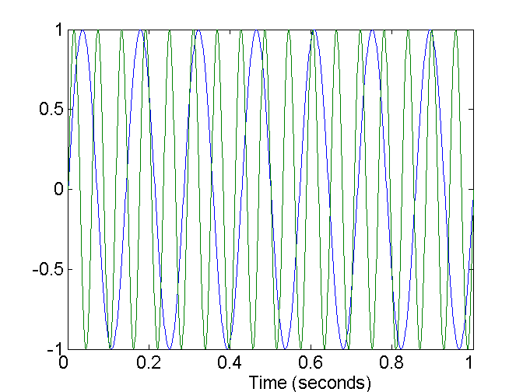
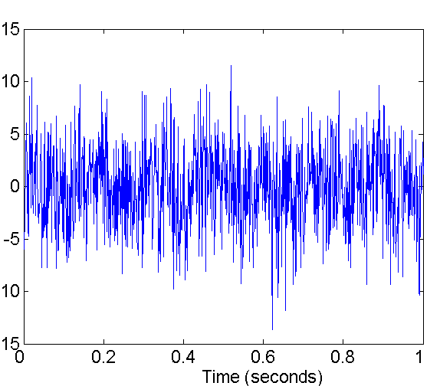
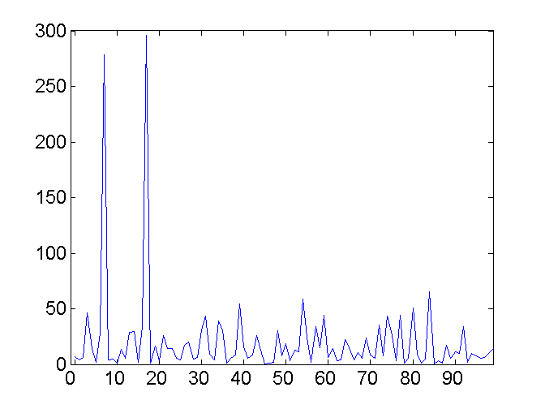
Mapping Data to a New Space
Fourier transform
Wavelet transform
Two Sine Waves
Two Sine Waves + Noise
Frequency

Slide 9
Discretization
Three types of attributes:
Nominal — values from an unordered set
Ordinal — values from an ordered set
Continuous — real numbers
Discretization:
divide the range of a continuous attribute into intervals
Some classification algorithms only accept categorical attributes.
Reduce data size by discretization
Prepare for further analysis

Slide 10
Discretization and Concept hierachy
Discretization
reduce the number of values for a given continuous attribute by dividing the range of the attribute into intervals. Interval labels can then be used to replace actual data values
Concept hierarchies
reduce the data by collecting and replacing low level concepts (such as numeric values for the attribute age) by higher level concepts (such as young, middle-aged, or senior)

Slide 11
Concept Hierarchy Generation for Categorical Data
Specification of a partial ordering of attributes explicitly at the schema level by users or experts
street<city<state<country
Specification of a portion of a hierarchy by explicit data grouping
{Urbana, Champaign, Chicago}<Illinois
Specification of a set of attributes.
System automatically generates partial ordering by analysis of the number of distinct values
E.g., street < city <state < country
Specification of only a partial set of attributes
E.g., only street < city, not others

Slide 12
Automatic Concept Hierarchy Generation
Some concept hierarchies can be automatically generated based on the analysis of the number of distinct values per attribute in the given data set
The attribute with the most distinct values is placed at the lowest level of the hierarchy
Note: Exception—weekday (7), month(12), year(may be last 20 years data)
country
15 distinct values
province_or_ state
65 distinct values
city
3567 distinct values
street
674,339 distinct values

Slide 13
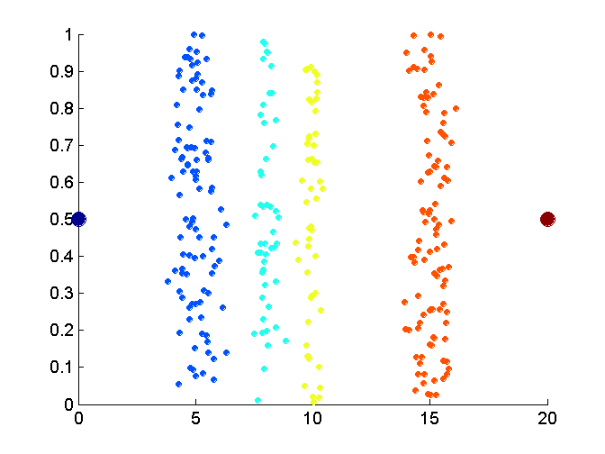
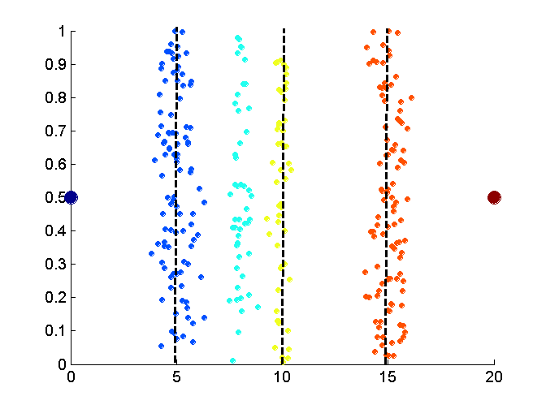
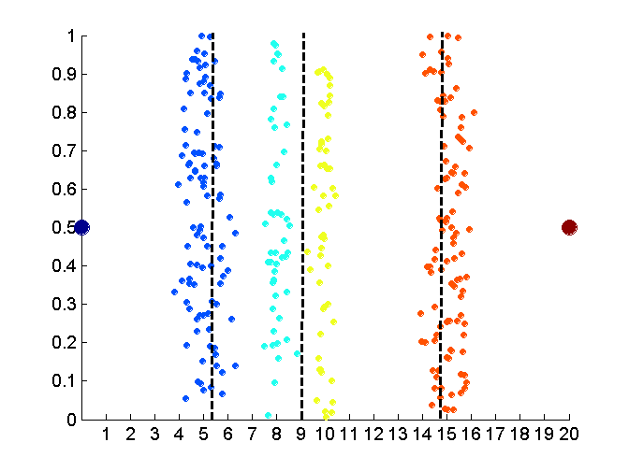
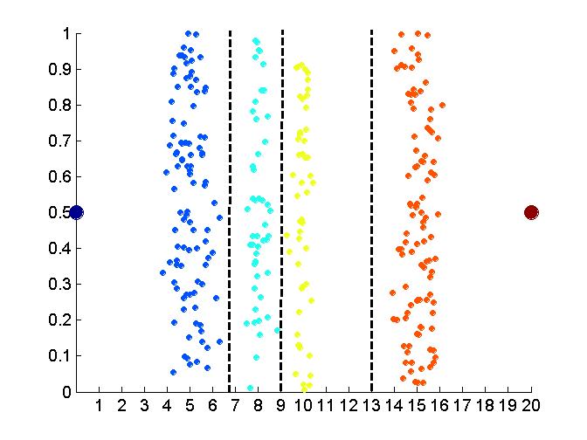
Discretization Without Using Class Labels
Data
Equal interval width
Equal frequency
K-means

Slide 14
Entropy-based discretization
Information-based measure – entropy
Recursively partition the values of a numeric attribute (hierarchical discretization)
Method: Given a set of tuples, S, basic method for entropy-based discretization of A (attribute) is as follows:

Slide 15
Cont’d
Each value of A can be considered a potential interval boundary or threshold T. For example, a value v of A can partition the samples in S into two subsets satisfying the condition A < v and A >= v – binary discretization
Given S, the threshold value selected if the one that maximizes the information gain resulting from subsequent partitioning.

Slide 16
Information gain
S₁ and S₂ – the samples in S satisfying the condition A < T and A >=T

Slide 17
Entropy function
Ent for a given set is calculated based on the class distribution of the samples in the set. Eg, given m classes, the entropy of S₁ is
P_{i} – probability of class i in S₁, determined by dividing the number of samples of class i in S₁ by the total number of samples in S₁

Slide 18
Entropy-based (1)
Given attribute-value/class pairs:
(0,P), (4,P), (12,P), (16,N), (16,N), (18,P), (24,N), (26,N), (28,N)
Entropy-based binning via binarization:
Intuitively, find best split so that the bins are as pure as possible
Formally characterized by maximal information gain.
Let S denote the above 9 pairs, p=4/9 be fraction of P pairs, and n=5/9 be fraction of N pairs.
Entropy(S) = - p log p - n log n.
Smaller entropy – set is relatively pure; smallest is 0.
Large entropy – set is mixed. Largest is 1.

Slide 19
Entropy-based (2)
Let v be a possible split. Then S is divided into two sets:
S1: value <= v and S2: value > v
Information of the split:
I(S1,S2) = (|S1|/|S|) Entropy(S1)+ (|S2|/|S|) Entropy(S2)
Goal: split with maximal information gain.
Possible splits: mid points b/w any two consecutive values.

Slide 20
Cont.
For v=14
I(S1,S2) = 0 + 6/9*Entropy(S2)
= 6/9 * 0.65
= 0.433
The best split is found after examining all possible splits.
Try for v 16, find I(S1,S2) ?
The process of determining a threshold value is recursively applied until the following stopping criteria
The above example no more splitting because S1&S@ contains purely class, i.e., all P and all N

Slide 21
Example: fair coin throw
P (head) = 0.5
P (tail) = 0.5
Example: Coin Flip
A_{X} = {heads, tails}
P(heads) = P(tails) = ½
½ log₂(½) = ½ * - 1
H(X) = 1

Slide 22
Example: biased coin throw
What about a two-headed coin?
Conditional Entropy:
P(head) | 0.5 | 0.25 | 0.1 | 0
P(tail) | 0.5 | 0.75 | 0.9 | 1
Entropy | 1 | 0.811 | 0.469 | 0.000

Slide 23
Entropy of a split
Information in a split with x items of one class, y items of the second class

Slide 24
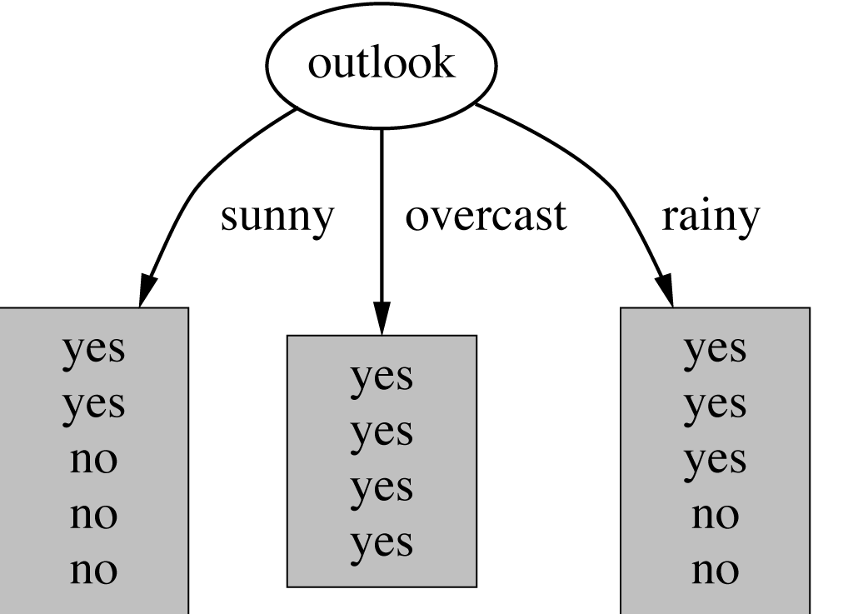
Example: attribute “Outlook”
“Outlook” = “Sunny”: 2 and 3 split

Slide 25
Outlook = Overcast
“Outlook” = “Overcast”: 4/0 split
Note: log(0) is not defined, but we evaluate 0*log(0) as zero

Slide 26
Outlook = Rainy
“Outlook” = “Rainy”:

Slide 27
Expected Information
Expected information for attribute:

Slide 28
Computing the information gain
Information gain:
(information before split) – (information after split)
Information gain for attributes from weather data:

Slide 29
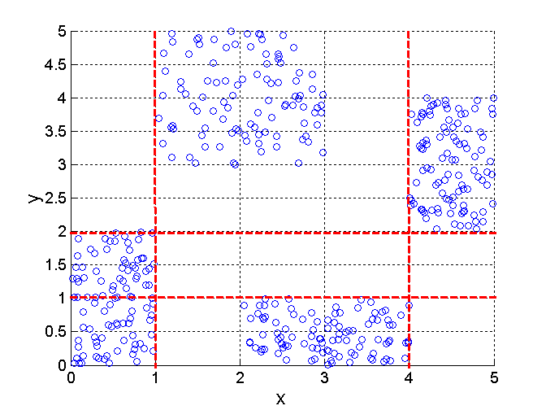
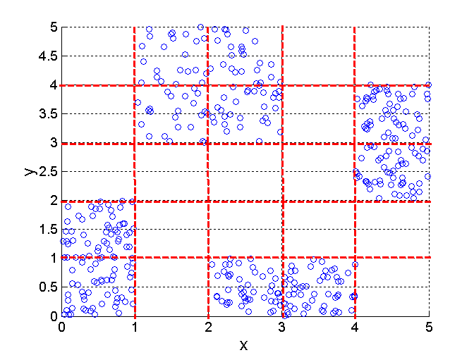
Discretization Using Class Labels
Entropy based approach
3 categories for both x and y
5 categories for both x and y

Slide 30
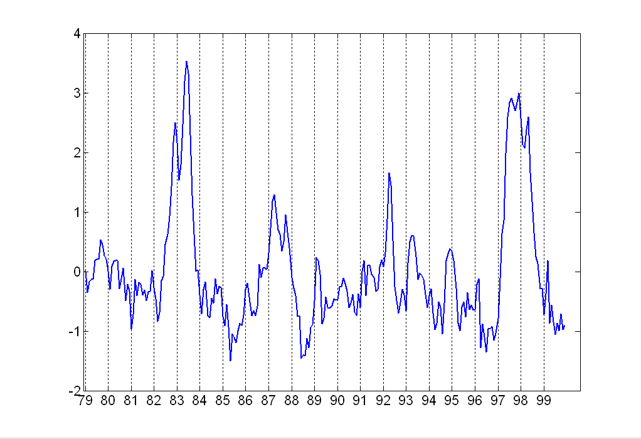
Attribute Transformation
A function that maps the entire set of values of a given attribute to a new set of replacement values such that each old value can be identified with one of the new values
Simple functions: x^{k}, log(x), e^{x}, |x|
Standardization and Normalization

Slide 31
Numerosity Reduction
Reduce the data volume by choosing alternative ‘smaller’ forms of data representation
Two type:
Parametric – a model is used to estimate the data, only the data parameters is stored instead of actual data
regression
log-linear model
Nonparametric –storing reduced representation of the data
Histograms
Clustering
Sampling

Slide 32
Regression and Log-Linear Models
Linear regression: Data are modeled to fit a straight line
Often uses the least-square method to fit the line
Multiple regression: allows a response variable Y to be modeled as a linear function of multidimensional feature vector
Log-linear model: approximates discrete multidimensional probability distributions

Slide 33
Regression
Develop a model to predict the salary of college graduates with 10 years working experience
Potential sales of a new product given its price
Regression - used to approximate the given data
The data are modeled as a straight line.
A random variable Y (response variable), can be modeled as a linear function of another random variable, X (predictor variable), with the equation

Slide 34
Cont’d
The variance of Y is assumed to be constant
α and β (regression coefficients) – Y-intercept and the slope line.
Can be solved by the method of least squares. (minimizes the error between actual line separating data and the estimate of the line)

Slide 35
Cont’d

Slide 36
Regress Analysis and Log-Linear Models
Linear regression: Y = α + β X
Two parameters , α and β specify the line and are to be estimated by using the data at hand.
using the least squares criterion to the known values of Y1, Y2, …, X1, X2, ….
Multiple regression: Y = b0 + b1 X1 + b2 X2.
Many nonlinear functions can be transformed into the above.
Log-linear models:
The multi-way table of joint probabilities is approximated by a product of lower-order tables.
Probability: p(a, b, c, d) = αab βacχad δbcd

Slide 37
Histograms
A popular data reduction technique
Divide data into buckets and store average (sum) for each bucket
Can be constructed optimally in one dimension using dynamic programming
Related to quantization problems.

Slide 38
Clustering
Partition data set into clusters, and one can store cluster representation only
Can be very effective if data is clustered but not if data is “smeared”
Can have hierarchical clustering and be stored in multi-dimensional index tree structures
There are many choices of clustering definitions and clustering algorithms, further detailed in Chapter 8

Slide 39
Data Compression
String compression
There are extensive theories and well-tuned algorithms
Typically lossless
But only limited manipulation is possible without expansion
Audio/video compression
Typically lossy compression, with progressive refinement
Sometimes small fragments of signal can be reconstructed without reconstructing the whole

Slide 40
Data Compression
Original Data
Compressed
Data
lossless
Original Data
Approximated
lossy

Slide 41
Wavelet Transformation
Haar2
Daubechie4
Discrete wavelet transform (DWT): linear signal processing, multi-resolutional analysis
Compressed approximation: store only a small fraction of the strongest of the wavelet coefficients
Similar to discrete Fourier transform (DFT), but better lossy compression, localized in space
Method:
Length, L, must be an integer power of 2 (padding with 0s, when necessary)
Each transform has 2 functions: smoothing, difference
Applies to pairs of data, resulting in two set of data of length L/2
Applies two functions recursively, until reaches the desired length

Slide 42
Similarity and Dissimilarity
Similarity
Numerical measure of how alike two data objects are.
Is higher when objects are more alike.
Often falls in the range [0,1]
Dissimilarity
Numerical measure of how different are two data objects
Lower when objects are more alike
Minimum dissimilarity is often 0
Upper limit varies
Proximity refers to a similarity or dissimilarity

Slide 43
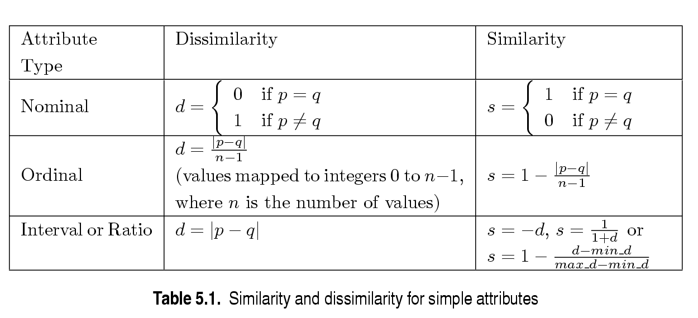
Similarity/Dissimilarity for Simple Attributes
p and q are the attribute values for two data objects.

Slide 44
Euclidean Distance
Euclidean Distance
Where n is the number of dimensions (attributes) and p_{k} and q_{k} are, respectively, the k^{th} attributes (components) of data objects p and q.
Standardization is necessary, if scales differ.

Slide 45
Euclidean Distance
Distance Matrix

Slide 46
Minkowski Distance
Minkowski Distance is a generalization of Euclidean Distance
Where r is a parameter, n is the number of dimensions (attributes) and p_{k} and q_{k} are, respectively, the kth attributes (components) or data objects p and q.

Slide 47
Minkowski Distance: Examples
r = 1. City block (Manhattan, taxicab, L₁ norm) distance.
A common example of this is the Hamming distance, which is just the number of bits that are different between two binary vectors
r = 2. Euclidean distance
r → ∞. “supremum” (L_{max} norm, L∞ norm) distance (also known as Chebyshev distance)..
This is the maximum difference between any component of the vectors
Do not confuse r with n, i.e., all these distances are defined for all numbers of dimensions.

Slide 48
Minkowski Distance
Distance Matrix

Slide 49
Common Properties of a Distance
Distances, such as the Euclidean distance, have some well known properties.
d(p, q) ≥ 0 for all p and q and d(p, q) = 0 only if p = q. (Positive definiteness)
d(p, q) = d(q, p) for all p and q. (Symmetry)
d(p, r) ≤ d(p, q) + d(q, r) for all points p, q, and r. (Triangle Inequality)
where d(p, q) is the distance (dissimilarity) between points (data objects), p and q.
A distance that satisfies these properties is a metric

Slide 50
Common Properties of a Similarity
Similarities, also have some well known properties.
s(p, q) = 1 (or maximum similarity) only if p = q.
s(p, q) = s(q, p) for all p and q. (Symmetry)
where s(p, q) is the similarity between points (data objects), p and q.

Slide 51
Similarity Between Binary Vectors
Common situation is that objects, p and q, have only binary attributes
Compute similarities using the following quantities
M₀₁ = the number of attributes where p was 0 and q was 1
M₁₀ = the number of attributes where p was 1 and q was 0
M₀₀ = the number of attributes where p was 0 and q was 0
M₁₁ = the number of attributes where p was 1 and q was 1
Simple Matching and Jaccard Coefficients
SMC = number of matches / number of attributes
= (M₁₁ + M₀₀) / (M₀₁ + M₁₀ + M₁₁ + M₀₀)
J = number of 11 matches / number of not-both-zero attributes values
= (M₁₁) / (M₀₁ + M₁₀ + M₁₁)

Slide 52
SMC versus Jaccard: Example
p = 1 0 0 0 0 0 0 0 0 0
q = 0 0 0 0 0 0 1 0 0 1
M₀₁ = 2 (the number of attributes where p was 0 and q was 1)
M₁₀ = 1 (the number of attributes where p was 1 and q was 0)
M₀₀ = 7 (the number of attributes where p was 0 and q was 0)
M₁₁ = 0 (the number of attributes where p was 1 and q was 1)
SMC = (M₁₁ + M₀₀)/(M₀₁ + M₁₀ + M₁₁ + M₀₀) = (0+7) / (2+1+0+7) = 0.7
J = (M₁₁) / (M₀₁ + M₁₀ + M₁₁) = 0 / (2 + 1 + 0) = 0

Slide 53
Cosine Similarity
If d₁ and d₂ are two document vectors, then
cos( d₁, d₂ ) = (d₁ • d₂) / ||d₁|| ||d₂|| ,
where • indicates vector dot product and || d || is the length of vector d.
Example:
d₁ = 3 2 0 5 0 0 0 2 0 0
d₂ = 1 0 0 0 0 0 0 1 0 2
d₁ • d₂= 3*1 + 2*0 + 0*0 + 5*0 + 0*0 + 0*0 + 0*0 + 2*1 + 0*0 + 0*2 = 5
||d₁|| = (3*3+2*2+0*0+5*5+0*0+0*0+0*0+2*2+0*0+0*0)^{0.5} = (42) ^{0.5} = 6.481
||d₂|| = (1*1+0*0+0*0+0*0+0*0+0*0+0*0+1*1+0*0+2*2) ^{0.5} = (6) ^{0.5} = 2.245
cos( d₁, d₂ ) = .3150

Slide 54
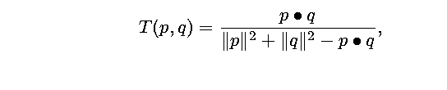
Extended Jaccard Coefficient (Tanimoto)
Variation of Jaccard for continuous or count attributes
Reduces to Jaccard for binary attributes

Slide 55
Correlation Analysis (Nominal Data)
Χ² (chi-square) test
The larger the Χ² value, the more likely the variables are related
The cells that contribute the most to the Χ² value are those whose actual count is very different from the expected count
Correlation does not imply causality
# of hospitals and # of car-theft in a city are correlated
Both are causally linked to the third variable: population

Slide 56
Chi-Square Calculation: An Example
Χ² (chi-square) calculation (numbers in parenthesis are expected counts calculated based on the data distribution in the two categories)
It shows that like_science_fiction and play_chess are correlated in the group
 | Play chess | Not play chess | Sum (row)
Like science fiction | 250(90) | 200(360) | 450
Not like science fiction | 50(210) | 1000(840) | 1050
Sum(col.) | 300 | 1200 | 1500

Slide 57
Correlation Analysis (Numeric Data)
Correlation coefficient (also called Pearson’s product moment coefficient)
where n is the number of tuples, and are the respective means of A and B, σ_{A} and σ_{B} are the respective standard deviation of A and B, and Σ(a_{i}b_{i}) is the sum of the AB cross-product.
If r_{A,B} > 0, A and B are positively correlated (A’s values increase as B’s). The higher, the stronger correlation.
r_{A,B} = 0: independent; r_{AB} < 0: negatively correlated

Slide 58
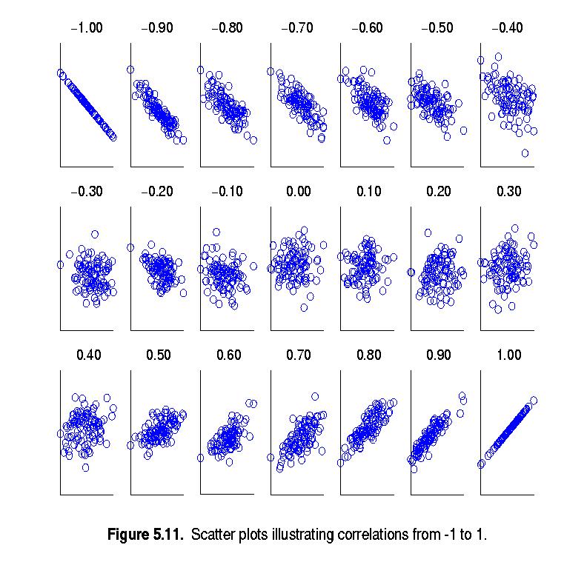
Visually Evaluating Correlation
Scatter plots showing the similarity from –1 to 1.

Slide 59
Correlation
Correlation measures the linear relationship between objects
To compute correlation, we standardize data objects, p and q, and then take their dot product

Slide 60
Correlation analysis
Can detect redundancies

Slide 61
Cont’d
> 0 , A and B positively correlated
values of A increase as values of B increase
The higher the value, the more each attribute implies the other
High value indicate that A (or B) may be removed as a redundancy
= 0, A and B independent (no correlation)
< 0, A and B negatively correlated
Values of one attribute increase as the values of the other attribute decrease (discourages each other)

Slide 62
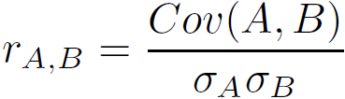
Covariance (Numeric Data)
Covariance is similar to correlation
where n is the number of tuples, and are the respective mean or expected values of A and B, σ_{A} and σ_{B} are the respective standard deviation of A and B.
Positive covariance: If Cov_{A,B} > 0, then A and B both tend to be larger than their expected values.
Negative covariance: If Cov_{A,B} < 0 then if A is larger than its expected value, B is likely to be smaller than its expected value.
Independence: Cov_{A,B} = 0 but the converse is not true:
Some pairs of random variables may have a covariance of 0 but are not independent. Only under some additional assumptions (e.g., the data follow multivariate normal distributions) does a covariance of 0 imply independence
Correlation coefficient:

Slide 63

Co-Variance: An Example
It can be simplified in computation as
Suppose two stocks A and B have the following values in one week: (2, 5), (3, 8), (5, 10), (4, 11), (6, 14).
Question: If the stocks are affected by the same industry trends, will their prices rise or fall together?
E(A) = (2 + 3 + 5 + 4 + 6)/ 5 = 20/5 = 4
E(B) = (5 + 8 + 10 + 11 + 14) /5 = 48/5 = 9.6
Cov(A,B) = (2×5+3×8+5×10+4×11+6×14)/5 − 4 × 9.6 = 4
Thus, A and B rise together since Cov(A, B) > 0.

Slide 64
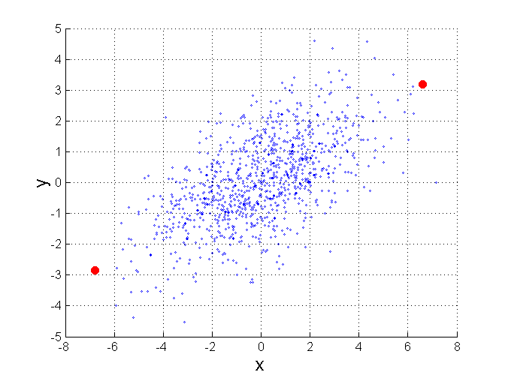
Mahalanobis Distance
Σ is the covariance matrix of the input data X
For red points, the Euclidean distance is 14.7, Mahalanobis distance is 6.

Slide 65
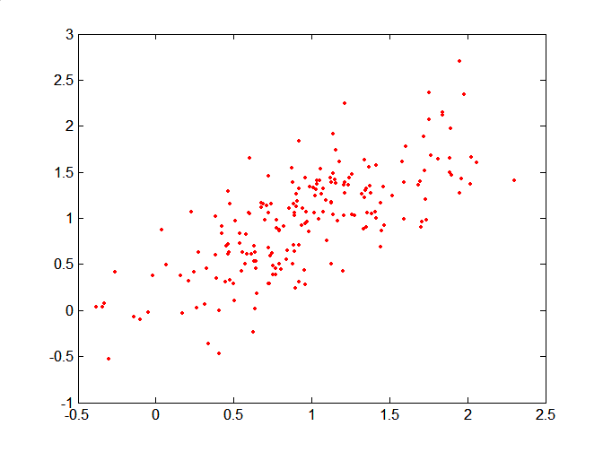
Mahalanobis Distance
Covariance Matrix:
C
B
A: (0.5, 0.5)
B: (0, 1)
C: (1.5, 1.5)
Mahal(A,B) = 5
Mahal(A,C) = 4
A

Slide 66
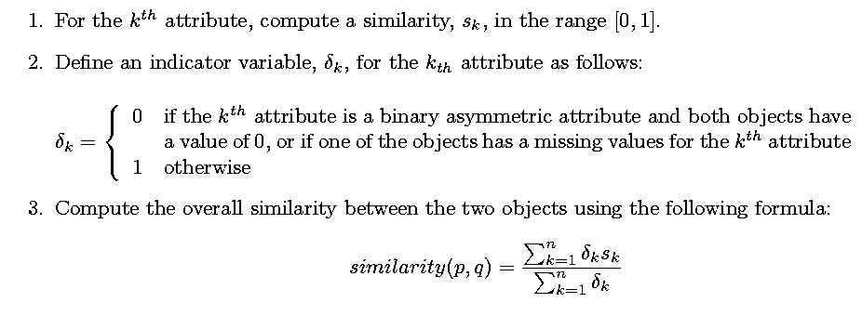
General Approach for Combining Similarities
Sometimes attributes are of many different types, but an overall similarity is needed.

